Slide 1
Neural Networks
Where They Came From, How One Works, and an Example

Slide 2
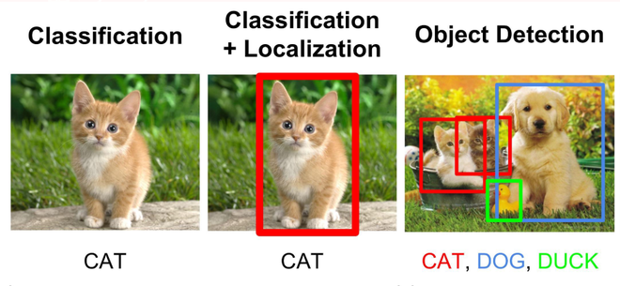
Introduction to Artificial Neural Networks (ANNs)
ANNs are a kind of machine learning algorithm that can perform simple regression and classification tasks. They are common for complex classification tasks such as computer vision (CV) and natural language processing (NLP).
https://www.geeksforgeeks.org/what-is-image-classification/

Slide 3

History of ANNs
Artificial Neural Networks were not created to solve challenging computational problems. Rather, they were inspired by attempts to study the human brain
"The holy grail was to build a model of the brain we could tinker with." – Kenneth Wenger
Note: Many of the ideas for this lecture, especially on the history of ANNs, came from Wenger's book.

Slide 4
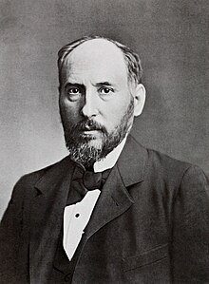
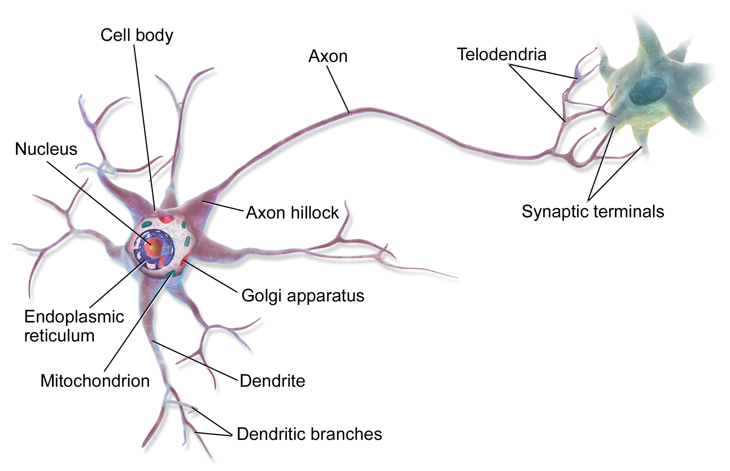
History of ANNs
Santiago Ramón y Cajal (Neuroscientist)
Discovered that the brain was composed of individual neurons which were the fundamental unit of thought.
1906 Nobel Prize with Italian Biologist Camillo Golgi for detailed illustrations and analysis of nerve cells based on examining dyed brain specimens.
Law of Dynamic Polarization: nerve cells have inputs (dendrites) and an output (axon).
BruceBlaus, CC BY 3.0 via Wikimedia Commons

Slide 5
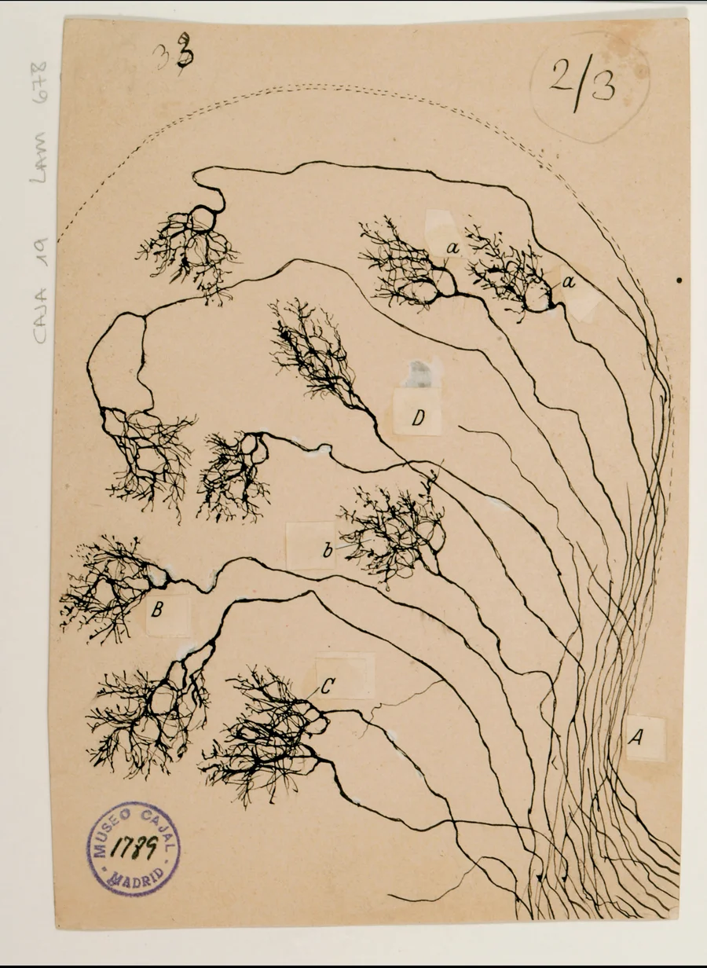
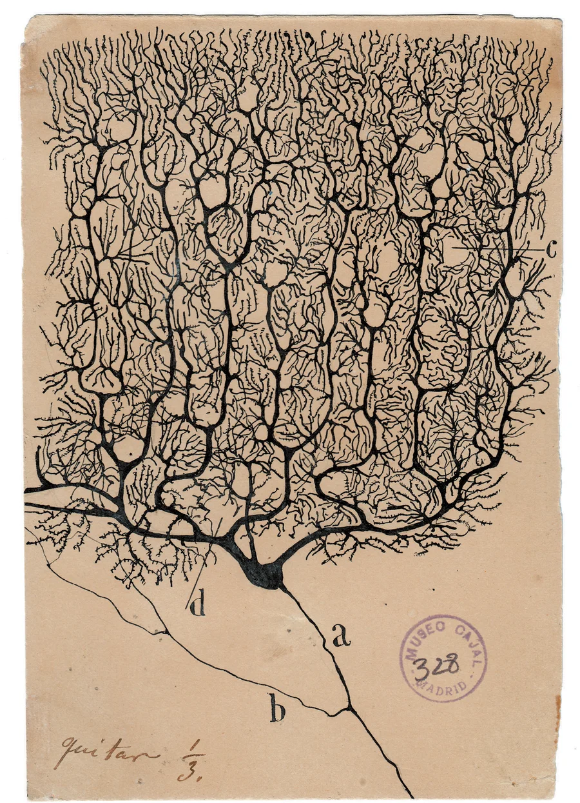
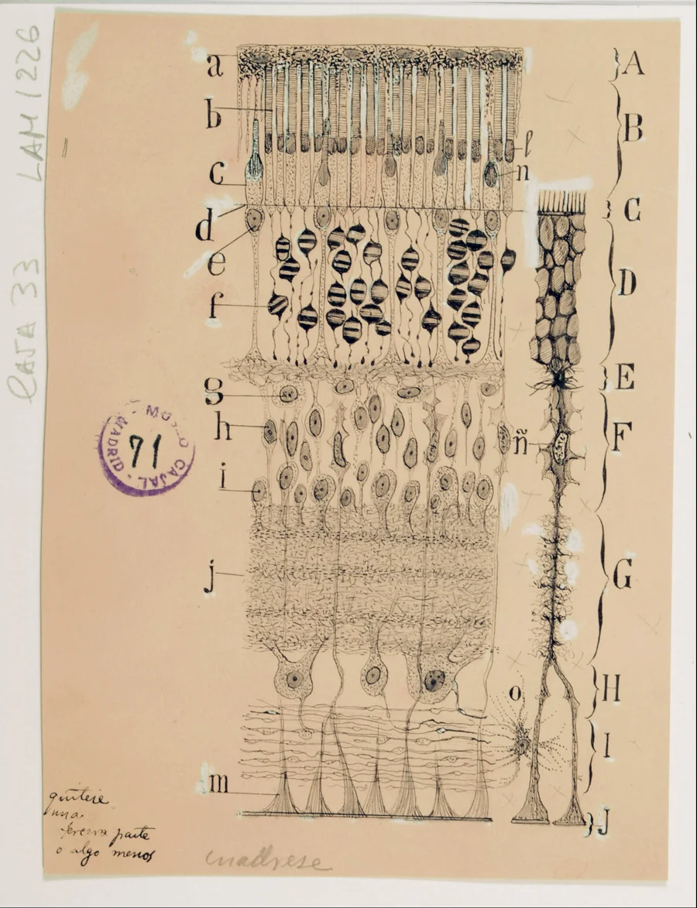
Texture of the Nervous System of Man and the Vertebrates
Image credit: Cajal Institute, Cajal Legacy, Spanish National Research Council (CSIC), Madrid, Spain
As found on scientificamerican.com

Slide 6
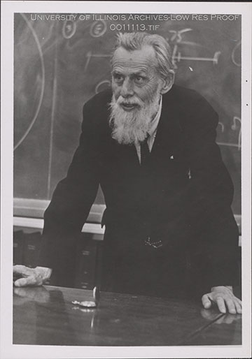
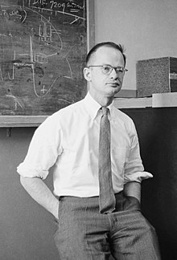
History of ANNs
Warren McCulloch (Neuropsychologist) and Walter Pitts (Logician)
Proposed first model for an artificial neuron in 1943 paper, "A Logical Calculus of Ideas Immanent in Nervous Activity."
Neuron had inputs X and single output Y. Node signaled if sum of the inputs was greater than some activation threshold value.
Problem: node was binary but brain appeared to work more like an analog circuit.
BruceBlaus, CC BY 3.0 via Wikimedia Commons

Slide 7
McCulloch-Pitts Neuron
Notice any similarities to digital logic gates?
∑inputs > firing threshold (2)
x₁
Binary Input X 0s or 1s
Binary Output y 0 or 1
x₂
y
2
(axon)
x₃
(dendrites)

Slide 8
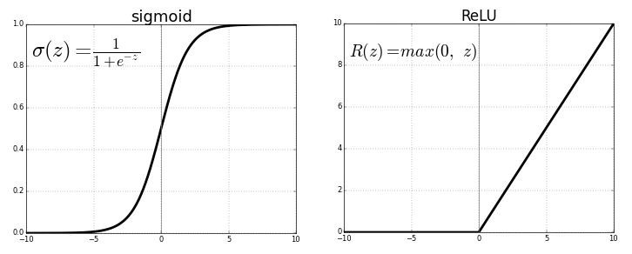
Other Activation Functions
Sigmoid Activation Function
Rectified Linear Unit Activation Function
Images posted to stats.stackexchange.com by user ironman

Slide 9
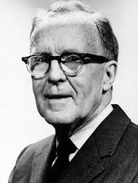
History of ANNs
Donald Hebb (Psychologist)
Published "The Organization of Behavior" in 1949 to introduce the idea of Hebbian Learning.
As nearby neurons fire, A ⇒ B, the connection between them grows, which establishes influence (learning).
Gave rise to assigning dynamic weights to each node's input (learning).
x₁
w₁
x₂
y
w₂
2
w₃
x₃

Slide 10
Exercise
Select the weights w₁ w₂ w₃ and the activation threshold to implement a triple-input AND gate and then do it again for a triple-input OR gate.
x₁
__
Binary Input X 0s or 1s
Binary Output y 0 or 1
x₂
y
__
__
__
x₃

Slide 11
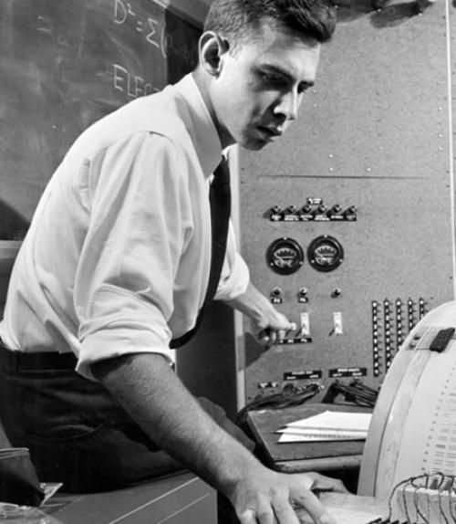
History of ANNs
Frank Rosenblatt (Psychologist)
Designed Perceptron while working for Cornell Aeronautical Lab under U.S. Naval Research grant.
Inputs no longer needed to be binary, now they were real number values [0,1].
Closest model yet to the human brain.
Focused on relatively few genotypic brain functions as opposed to many distinct monotypic "wet" algorithms.
x₁
w₁
x₂
y
w₂
2
w₃
x₃

Slide 12
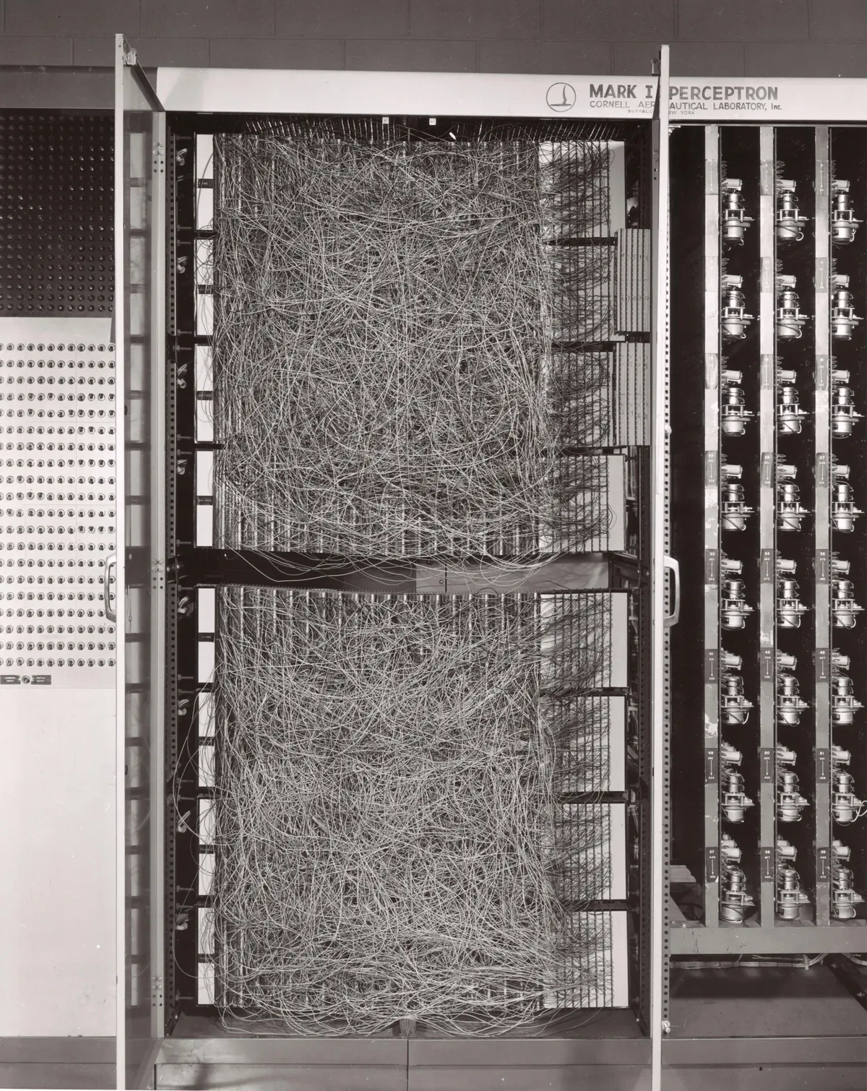
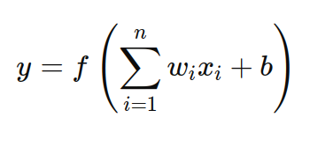
Mark 1 Perceptron (1958)
First known hardware implementation of an ANN
20x20 pixel image recognition (i.e., 400 inputs).
Weights encoded with potentiometers that could be turned by motors during the learning process.
If y > activation threshold ⇒ 1 otherwise 0

Slide 13
Exercise
Design an XOR gate by selecting the weights w₁ w₂ and the activation threshold.
x₁
__
Binary Input X 0s or 1s
Binary Output y 0 or 1
y
__
__
x₂

Slide 14
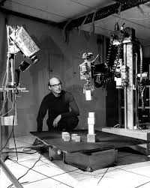
History of ANNs
Marvin Minsky (Computer Scientist)
Coauthored 1969 book Perceptron that critiqued the inability of perceptron node to implement an XOR gate.
The problem was that single layer nodes were unable to learn non-linear relationships.
Single perceptron nodes could be stacked together to build a deeper, multilayer ANN which could solve nonlinear problems, but the computing requirements were too demanding for the 1960s.
Minsky's critique contributed to a 15-20 year AI winter.

Slide 15
Modern ANNs and Deep Learning
Multilayer Perceptrons (MLPs) combine multiple "neurons" together to form "deep" networks that are able to solve nonlinear problems.
Input layer:
One node
for each feature
Output layer:
One output node
for each class (binary classifier)
Two hidden layers (>1 == deep learning)

Slide 16
Example MLP: Loan Approval
h₁ and h₂ are ReLU activated
x₁ = credit score [0,1]
y is sigmoid activated
x₂ = DTIR [0,1]
y = 0/1
x₃ = employment stability [0,1]
h₂ = 3 nodes
h₁ = 4 nodes

Slide 17
Example MLP: Loan Approval
How did we know…
3 input nodes? 3 features
1 output node? binary classification
2 hidden layers? educated guess
H₁ with 4 nodes? educated guess
H₂ with 3 nodes? educated guess
ReLU activation? educated guess
ANN Equations
X = Input Data
H₁ = ReLU(W₁X + B₁)
H₂ = ReLU(W₂H₁ + B₂)
Y = Sigmoid(W₃H₂ + B₃)
W₁ has three weights; W₂ has four; and W₃ has three (one for each input)

Slide 18
Example MLP: Loan Approval
Loan Approval Training Data
Credit Score | DTI Ratio | Employment Stability | Loan Approved
0.8 | 0.2 | 1 | 1
0.5 | 0.5 | 0.5 | 0
0.9 | 0.1 | 0.8 | 1
0.4 | 0.7 | 0.2 | 0
(Extremely small training set, I know)

Slide 19
Example MLP: Loan Approval
ReLU activated
x₁ = credit score
Sigmoid activated
x₂ = DTIR
y = 0/1
x₃ = employment stability
Every individual connection has a weight W₁, W₂, W₃ and each node has a bias B₁, B₂, B₃

Slide 20
Example MLP: Loan Approval
B₁ = 0.024, -0.191, -0.172, -0.056
x₁ = credit score
0.248
h₁¹
0.5
0.762
Sigmoid activated
h₁²
x₂ = DTIR
0.1
0.790
y = 0/1
h₁³
0.271
0.8
h₁⁴
x₃ = employment stability
ReLU activated

Slide 21
Example MLP: Loan Approval
B₁ = 0.024, -0.191, -0.172, -0.056
x₁ = credit score
h₁¹
0.5
-0.069
Sigmoid activated
h₁²
-0.117
x₂ = DTIR
0.1
y = 0/1
0.384
h₁³
0.8
-0.232
h₁⁴
x₃ = employment stability
ReLU activated

Slide 22
Example MLP: Loan Approval
B₁ = 0.024, -0.191, -0.172, -0.056
x₁ = credit score
h₁¹
0.5
Sigmoid activated
0.324
h₁²
x₂ = DTIR
0.1
-0.117
y = 0/1
h₁³
-0.235
0.8
-0.233
h₁⁴
x₃ = employment stability
ReLU activated

Slide 23
Example MLP: Loan Approval
h₁¹ = ReLU(0.5×0.248 + 0.1×-0.069 + 0.8×0.324 + 0.024) = ReLU(0.400) ⇒ 0.400
h₁² = ReLU(0.5×0.762 + 0.1×-0.117 + 0.8×-0.117 - 0.191) = ReLU(0.085) ⇒ 0.085
h₁³ = ReLU(0.5×0.790 + 0.1×0.384 + 0.8×-0.235 - 0.172) = ReLU(0.073) ⇒ 0.073
h₁⁴ = ReLU(0.5×0.271 + 0.1×-0.232 + 0.8×-0.233 - 0.056) = ReLU(-0.130) ⇒ 0
Continue for h2… Continue for y…
⇒ Denied = 0.477
⇒ Approved = 0.523
Notice that the final output values sum to 1
(and the loan would be approved… barely)

Slide 24
Determining Weights and Bias
Weights and biases are calculated over a series of iterative cycles, called epochs, that slowly improve the performance of the neural network.
Initial weights and biases are random, but using a special type of algorithm that yields numbers that are optimized for the learning process.
Each epoch, the values are intelligently changed (Δx₁, Δx₂, Δx₃, etc.) using an error minimization algorithm such as gradient descent. For now, the process is magic, but we will examine it closely in the near future.
Standardized data works best for gradient descent algorithms.
Learning cycles continue, at some pace alpha, until the learning stops (convergence) or we reach some maximum number of iterations.
This final set of weights and biases represent a fully trained model.

Slide 25
MLP Summary
Multilayer Perceptron Networks are one of the simplest neural networks
Each feature is an input node (N features ⇒ N input nodes)
Classification: each class is an output node (but binary classification will often "cheat" with only use a single node) Regression: one node per output value, but MLPs can output multiple values
Hidden layers between input and output affect complexity of model
Every node has an activation function (Threshold, ReLU, Sigmoid, etc.)
Usually, each node outputs to every node in the next layer
No feedback or loops: data travels forward from inputs to outputs
Initial weights are chosen "randomly" using specialized algorithms
Every epoch cycle, an error minimization function (aka gradient descent) improves the weights until the results converge or max iterations is reached

Slide 26
Types of Artificial Neural Networks
ANN should be a generic term, but often refers to a certain type of neural network.
Artificial Neural Network – one-way forward feed neural network (MLP)
Convolution Neural Network – uses convolution layers (think image processing) to process grid-like structures and detect spatial features
Recurrent Neural Network – based on sequential data (like speech) this network saves information between time intervals
Generative Adversarial Network – two main components, a generator that creates fake data and a discriminator that judges between real and fake
Transformer - improved RNN for certain tasks such as language processing

